Slide 1

Research Storage Simplified
John Reiland
October 24, 2025
Andrew Monaghan
rc-help@colorado.edu
Introduction to GPU Acceleration

Slide 2

View the Slides
https://github.com/ResearchComputing/Intro_GPU_Acceleration

Slide 3









Meet the User Support Team
Layla Freeborn
Brandon Reyes
Andy Monaghan
Michael Schneider
John
Reiland
Dylan Gottlieb
Mohal Khandelwal
Ragan
Lee
3

Slide 4



Session Overview
Basics
Of GPUs
Code
Optimization
Monitoring
GPU Usage
1
2
3
GPU Icon

Slide 5
CPUs vs GPUs
5

Slide 6
CPUs vs GPUs
Processing Unit
Central
6

Slide 7
CPUs vs GPUs
Processing Unit
Central
Graphics
7

Slide 8


CPUs vs GPUs
Dozens
Of Cores
(1 Core)
(1 Process)
8
Notes:
add icon for parallel calculations

Slide 9

CPUs vs GPUs
Thousands
Of Cores
(1 Calculation)
(1 Core)
Dozens
Of Cores
(1 Core)
(1 Process)
9
Notes:
add icon for parallel calculations

Slide 10
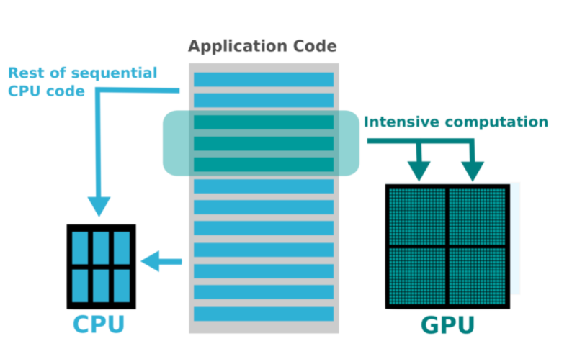
Computational Offloading
Graphic Source
10
Notes:
Expand on slide here to discuss how cpu & gpu work together
Source:
https://svi.nl/HuygensGPU

Slide 11
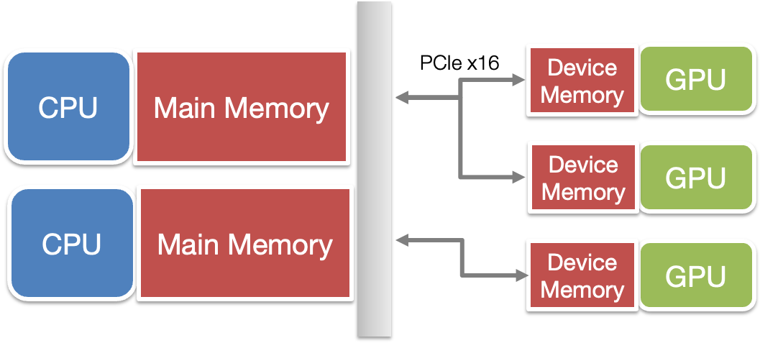
Data Offloading CPU -> GPU
Data needs to be copied from CPU to GPU, computation is on the GPU, then output is transferred back to CP8 U.

Slide 12
Criteria for GPU Acceleration
The time spent on computationally intensive parts of the workflow exceeds the time spent transferring data to and from GPU memory
Computations are massively parallel- the computations can be broken down into hundreds or thousands of independent units of work

Slide 13
Factors Affecting GPU Speedup
1
Computational Intensity
2
Data Dependency
3
Data Type
4
Code/Algorithmic Complexity

Slide 14
Factors Affecting GPU Speedup
1
Computational Intensity
GPUs perform best when there is a lot of processing compared to loading and storing data (FLOP per Byte ratio).

Slide 15
Factors Affecting GPU Speedup
2
Data Dependency
Data Dependency- A situation in which an instruction is dependent on a result from a sequentially previous instruction before it can complete its execution. (avoid!)

Slide 16
Factors Affecting GPU Speedup
3
Data Type
Operations on strings are slow unless they can be treated as numbers.
Performance per GPU can vary if workflows include 16-bit and 64-bit floats.

Slide 17
Factors Affecting GPU Speedup
4
Code/Algorithmic Complexity
Simple code is better ported to GPUs.
Deeply-branched code and while-loops may perform poorly on GPUs
Recursive functions need to be re-written

Slide 18
Alpine GPU Partitions
 | NVIDIA |  |  | AMD
Partition | aa100 (atesting_a100) | al40 | gh200* | ami100 (attesting_mi100)
# Nodes | 12 | 3 | 2 | 8
GPU Type | A100 | L40 | GH200 | MI100
GPUs/Node | 3 | 3 | 1 | 3
Cores/GPU | 7k | 15K | 17k | 7.7k
VRAM/GPU | 40 / 80 | 48 | 96 | 32
Purpose | General | AI Inference | AI Training, High Data I/O | General
18
Notes:
Slide 6 - Update hardware information to match current numbers and include L20’s and Grace Hopper
List out all of the GPU partitions and what each is good for (pros / cons)
*Overall note – nvidia gpu’s focus on AI/ML workflows, while AMD provides stronger performance with general computing tasks (e.g. scientific operations that use large floating point values) – great option for scientific/precise computing.

Slide 19

Exploring Alpine GPU Partitions
Try these commands.
$ ssh <username>@login.rc.colorado.edu
$ sinfo --Format Partition
$ sinfo --partition aa100,ami100,atesting_a100,atesting_mi100 --Format=Partition,Nodes,Time
$ scontrol show partition atesting_a100
$ scontrol show node c3gpu-c2-u13

Slide 20
Requesting Alpine GPUs with Slurm batch script
#SBATCH --partition=aa100
#SBATCH --qos=normal
#SBATCH --gres=gpu:2 #SBATCH --nodes=1
#SBATCH --ntasks=20
#SBATCH --time=12:00:00
#SBATCH --job-name=gpu_test #SBATCH --output=gpu_test_%j.out #SBATCH --error=gpu_test_%j.err
Slurm flags needed to request 1 NVIDIA GPU node with 2 GPUs and 20 CPU cores
--partition=aa100
--gres=gpu:2
--ntasks=20
in a job script submitted with sbatch command

Slide 21

Requesting Alpine GPUs with Slurm interactive
#request one NVIDIA GPU on the A100 testing partition:
sinteractive --partition=atesting_a100 --qos=testing --gres=gpu:1 --nodes=1 --ntasks=10 --time=1:00:00
Note: Queue waits for non-testing GPU partitions are typically long (12-24 hours). Therefore, interactive jobs -- which require you to wait for the job to start -- will usually be run on the testing partitions during the onboarding and debugging stages of your workflow.

Slide 22
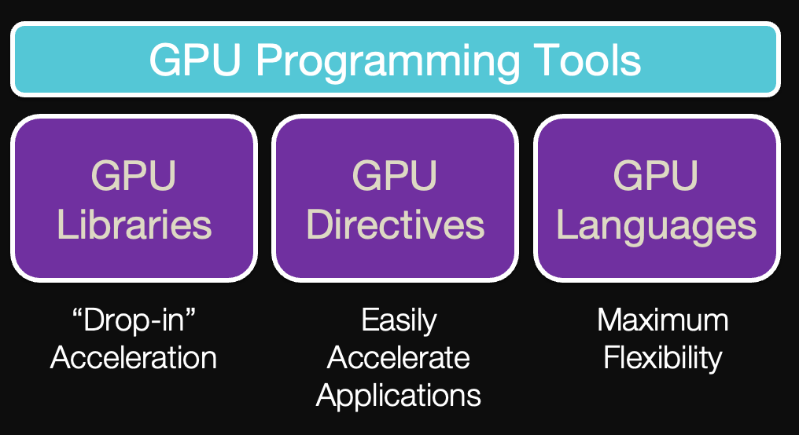
Code Optimization
GPU Icon

Slide 23

GPU Libraries – Drop in Replacement
https://rapids.ai
23

Slide 24
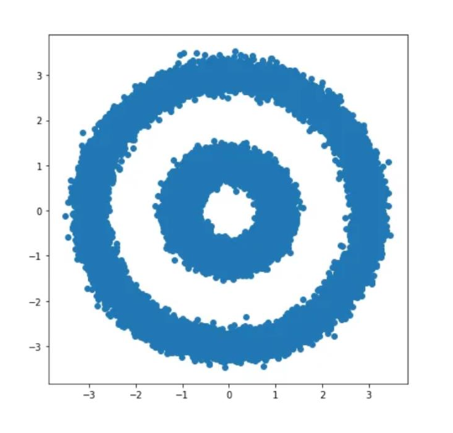
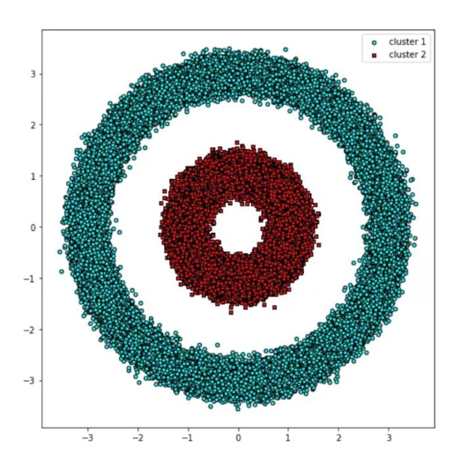
GPU Libraries – Drop in Replacement
#create dataset with 100,000 points
from sklearn.datasets import make_circles
X, y = make_circles(n_samples=int(1e5), factor=.35, noice=.05)
#run DBSCAN clustering algorithm
from sklearn.cluster import DBSCAN
db = DBSCAN(eps=0.6, min_samples=2)
y_db = db.fit_predict(X)
Dataset
Clusters
Input
Result
24

Slide 25
GPU Libraries – Drop in Replacement
#create dataset with 100,000 points
from sklearn.datasets import make_circles
X, y = make_circles(n_samples=int(1e5), factor=.35, noice=.05)
#run DBSCAN clustering algorithm
from sklearn.cluster import DBSCAN
db = DBSCAN(eps=0.6, min_samples=2)
y_db = db.fit_predict(X)
25

Slide 26
GPU Libraries – Drop in Replacement
#create dataset with 100,000 points
from sklearn.datasets import make_circles
X, y = make_circles(n_samples=int(1e5), factor=.35, noice=.05)
#convert dataset to Pandas DataFrame
#run DBSCAN clustering algorithm
from sklearn.cluster import DBSCAN
db = DBSCAN(eps=0.6, min_samples=2)
y_db = db.fit_predict(X)
26

Slide 27
GPU Libraries – Drop in Replacement
#create dataset with 100,000 points
from sklearn.datasets import make_circles
X, y = make_circles(n_samples=int(1e5), factor=.35, noice=.05)
#convert dataset to Pandas DataFrame
import pandas as pd
import cudf
X_df = pd.DataFrame({‘fea%d’%i: X[:,i] for i in range(X.shape[1])})
X_gpu = cudf.DataFrame.from_pandas(X_df)
#run DBSCAN clustering algorithm
from sklearn.cluster import DBSCAN
db = DBSCAN(eps=0.6, min_samples=2)
y_db = db.fit_predict(X)
27

Slide 28
GPU Libraries – Drop in Replacement
#create dataset with 100,000 points
from sklearn.datasets import make_circles
X, y = make_circles(n_samples=int(1e5), factor=.35, noice=.05)
#convert dataset to Pandas DataFrame
import pandas as pd
import cudf
X_df = pd.DataFrame({‘fea%d’%i: X[:,i] for i in range(X.shape[1])})
X_gpu = cudf.DataFrame.from_pandas(X_df)
#run DBSCAN clustering algorithm
from sklearn.cluster import DBSCAN
db = DBSCAN(eps=0.6, min_samples=2)
y_db = db.fit_predict(X)
#run GPU-accelerated DBSCAN
from cuml import DBSCAN
28

Slide 29
GPU Libraries – Drop in Replacement
#create dataset with 100,000 points
from sklearn.datasets import make_circles
X, y = make_circles(n_samples=int(1e5), factor=.35, noice=.05)
#convert dataset to Pandas DataFrame
import pandas as pd
import cudf
X_df = pd.DataFrame({‘fea%d’%i: X[:,i] for i in range(X.shape[1])})
X_gpu = cudf.DataFrame.from_pandas(X_df)
#run DBSCAN clustering algorithm
from sklearn.cluster import DBSCAN
db = DBSCAN(eps=0.6, min_samples=2)
y_db = db.fit_predict(X)
#run GPU-accelerated DBSCAN
from cuml import DBSCAN
29

Slide 30
GPU Libraries – Drop in Replacement
#create dataset with 100,000 points
from sklearn.datasets import make_circles
X, y = make_circles(n_samples=int(1e5), factor=.35, noice=.05)
#convert dataset to Pandas DataFrame
import pandas as pd
import cudf
X_df = pd.DataFrame({‘fea%d’%i: X[:,i] for i in range(X.shape[1])})
X_gpu = cudf.DataFrame.from_pandas(X_df)
#run GPU-accelerated DBSCAN
from cuml import DBSCAN
db = DBSCAN(eps=0.6, min_samples=2)
y_db = db.fit_predict(X)
1
2
30

Slide 31

GPU-Enabled Frameworks (deep learning)
Known for: comprehensiveness, scalability
Known for: Flexibility, pythonic, intuitive
Known for: Ease of use
Known for: Distributed training
31
Notes:
Transition – if you don’t have a drop-in library or framework for your project, you can still optimize your code to utilize GPUs – you’ll need to consider Compiler Directives.

Slide 32

GPU Compiler Directives
Key Terms
Host == CPU
Device == GPU
Kernel == Functions launched on GPU
32

Slide 33
GPU Compiler Directives
Kernel directives
Generate parallel accelerator kernels for the loop following the directive.
33

Slide 34
GPU Compiler Directives
Kernel directives
Generate parallel accelerator kernels for the loop following the directive.
//Hello_World_OpenACC.c
void Print_Hello_World()
{
#pragma acc kernels
for(int i=0; i<5; i++)
{
printf(“Hello World!\n”)
}
}
34

Slide 35
GPU Compiler Directives
Kernel directives
Generate parallel accelerator kernels for the loop following the directive.
Data directives
Generate code to manage specific data operations to support parallelism
//Hello_World_OpenACC.c
void Print_Hello_World()
{
#pragma acc kernels
for(int i=0; i<5; i++)
{
printf(“Hello World!\n”)
}
}
35

Slide 36
GPU Compiler Directives
Kernel directives
Generate parallel accelerator kernels for the loop following the directive.
Data directives
Generate code to manage specific data operations to support parallelism
//Hello_World_OpenACC.c
void Print_Hello_World()
{
#pragma acc kernels
for(int i=0; i<5; i++)
{
printf(“Hello World!\n”)
}
}
//Hello_World_OpenACC.c
#pragma acc data copy(a)
{
#pragma acc kernels
for(int i=0; i<5; i++)
{
printf(“Hello World!\n”)
}
}
36

Slide 37
GPU Languages
OpenCL (NVIDIA, AMD, & CPUs)
Flexible / portable option
HIP (AMD -> NVIDIA)
AMD developed
Can convert CUDA code via `hippify`
CUDA (NVIDIA only)
Most robust and largest developer community
37
Notes:
Reduce text and add logos for each language

Slide 38
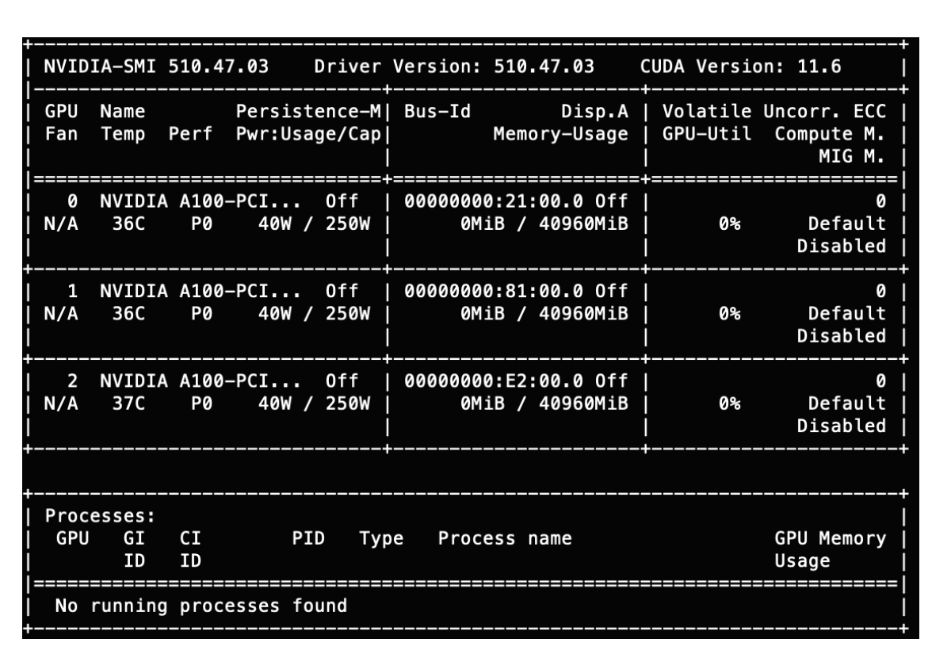
Monitoring GPU Usage
Nvidia-smi
rocm-smi
38

Slide 39
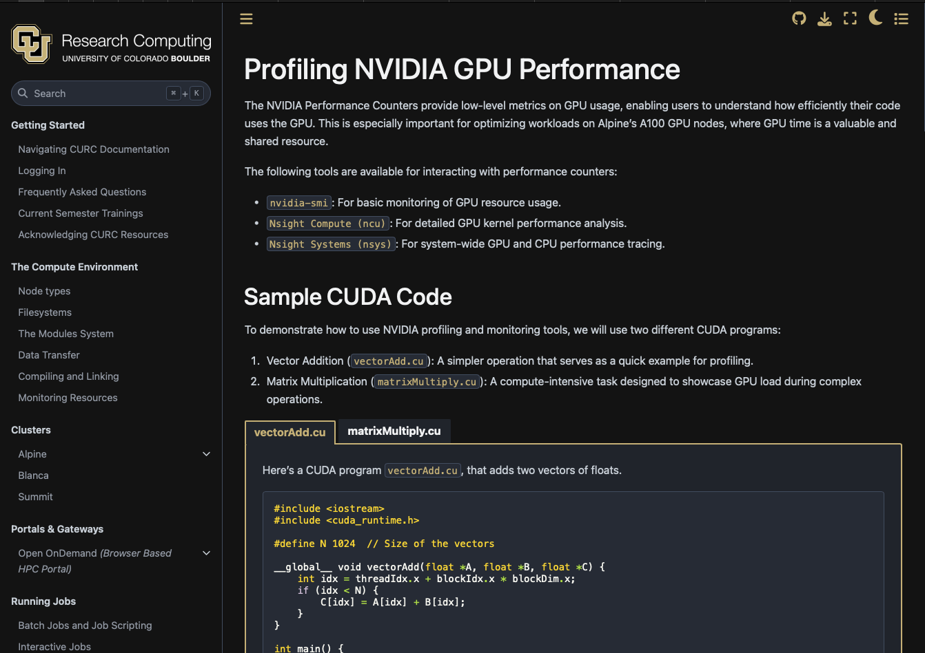
Monitoring GPU Usage on NVIDIA GPUs
https://curc.readthedocs.io/en/latest/programming/profiling-nvidia-gpu-performance.html
39

Slide 40
Troubleshooting GPU Workflows
• Is your application and/or code GPU accelerated?
Confirm that you installed the GPU accelerated version!
• Does your application or code support multi-GPU acceleration?
• Is your application ROCM- or CUDA-aware?
You can’t run CUDA code on AMD GPUs. Not all applications are available for AMD GPUs.
• Can your application “see” the GPU?
• Did you request enough CPUs and RAM?
40

Slide 41

Documentation
https://curc.readthedocs.io/en/latest/

Slide 42

Survey and feedback
Survey: http://tinyurl.com/curc-survey18

